Slide 1
The Semantic Web
Dr. Hammad Afzal
National University of Sciences and Technology, Pakistan
E-mail: hammad.afzal@mcs.edu.pk
Spring 2011
Courtesy: Prof Mark Baker (Reading University, UK)
Notes:
1

Slide 2
Outline
The problem.
The goals of the Semantic Web:
What is it for?
What is there now?
Where is it going?
The foundations for the Semantic Web:
Resource Description Framework (RDF),
Web Ontology Language (OWL).
Summary and Conclusions.
Spring 2011
Courtesy: Prof Mark Baker (Reading University, UK)
Notes:
2

Slide 3
What does this mean?
87354#ABU | 19
87355#ABU | 11
87356#ABU | 14
87357#ABU | 17
87358#ABU | 19
Spring 2011
Courtesy: Prof Mark Baker (Reading University, UK)
Notes:
3

Slide 4
Information
Product # | Cost in $
87354#ABU | 19
87355#ABU | 11
87356#ABU | 14
87357#ABU | 17
87358#ABU | 19
Spring 2011
Courtesy: Prof Mark Baker (Reading University, UK)
Notes:
4

Slide 5
What does this mean?
Product # | Cost in $
87354#ABU | 19
87355#ABU | 11
87356#ABU | 14
87357#ABU | 17
87358#ABU | 19
INFORMATION
=
DATA
+
STRUCTURE + INTERPRETATION
Spring 2011
Courtesy: Prof Mark Baker (Reading University, UK)
Notes:
5

Slide 6
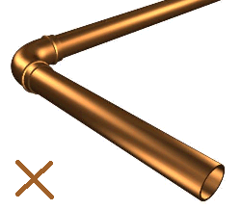
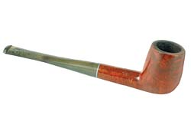
This is not
a pipe

Slide 7

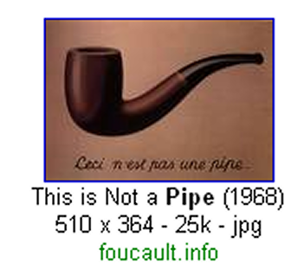



Slide 8
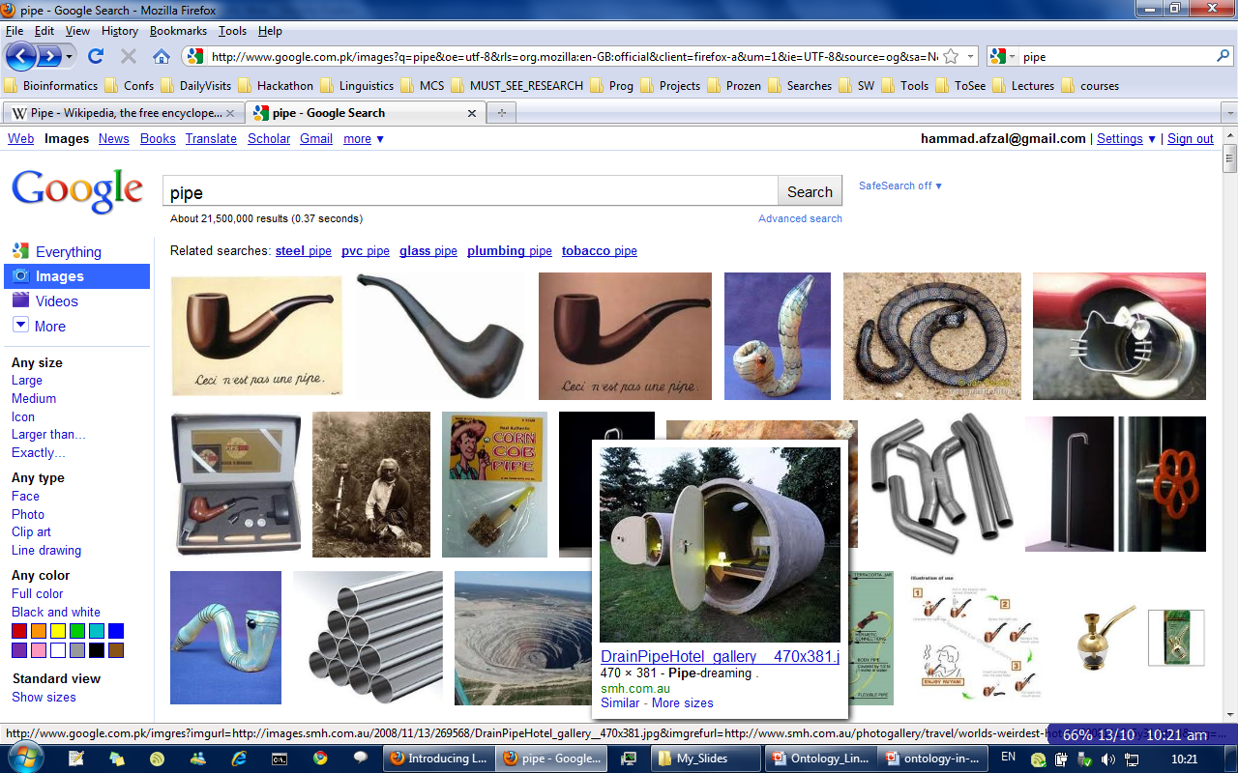

Slide 9
we interpret
machines don't

Slide 10
some knowledge
something is missing

Slide 11

History of the Semantic Web
Web was “invented” by Tim Berners-Lee (amongst others), a physicist working at CERN.
TBL’s original vision of the Web was much more ambitious than the reality of the existing (syntactic) Web:
TBL (and others) have since been working towards realising this vision, which has become known as the Semantic Web:
e.g., article in May 2001 issue of Scientific American…
“... a goal of the Web was that, if the interaction between person and hypertext could be so intuitive that the machine-readable information space gave an accurate representation of the state of people's thoughts, interactions, and work patterns, then machine analysis could become a very powerful management tool, seeing patterns in our work and facilitating our working together through the typical problems which beset the management of large organizations.”
Spring 2011
Courtesy: Prof Mark Baker (Reading University, UK)
Notes:
11

Slide 12

The Semantic Web
HTML for presentation
XML for data
RDF for meaning
Description
A new form of Web content that is meaningful to computers and will unleash a revolution of new possibilities…
Spring 2011
Courtesy: Prof Mark Baker (Reading University, UK)
Notes:
12
This picture is taken from a Scientific American article published in 2001. An easy take, though not entirely accurate, is to say that RDF (the semantic web language) adds ‘meaning’ to the data-focused XML. But really, RDF adds ‘description’ (that’s what the D stands for in Resource Description Framework, after all). In other words, with RDF we can better encode rich descriptions for computers to store, encode, transmit and process.

Slide 13
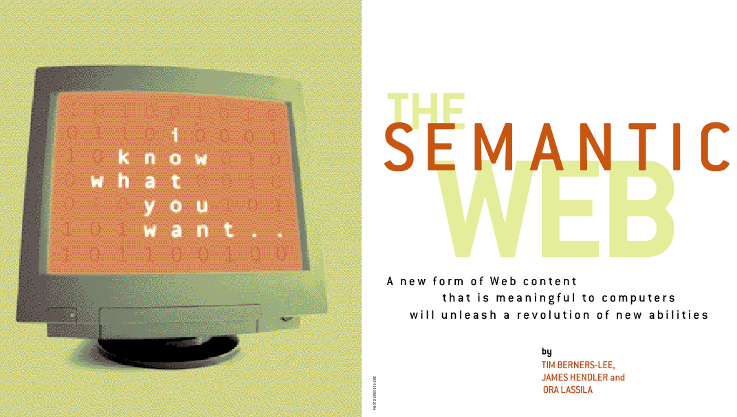
Scientific American, May 2001
Realising the complete “vision” is too hard for now (probably).
Spring 2011
Courtesy: Prof Mark Baker (Reading University, UK)
Notes:
13

Slide 14
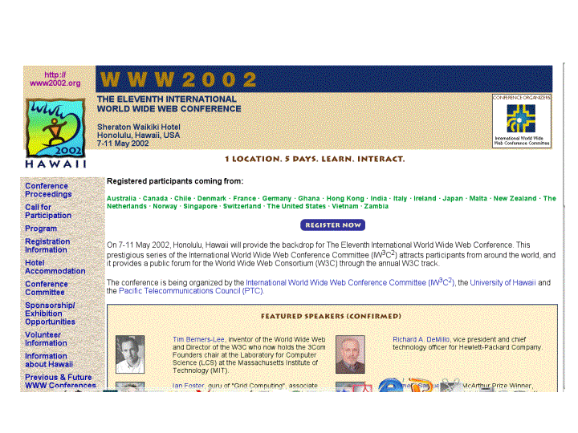
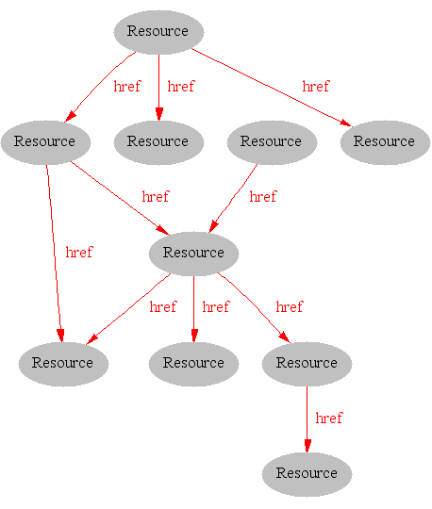
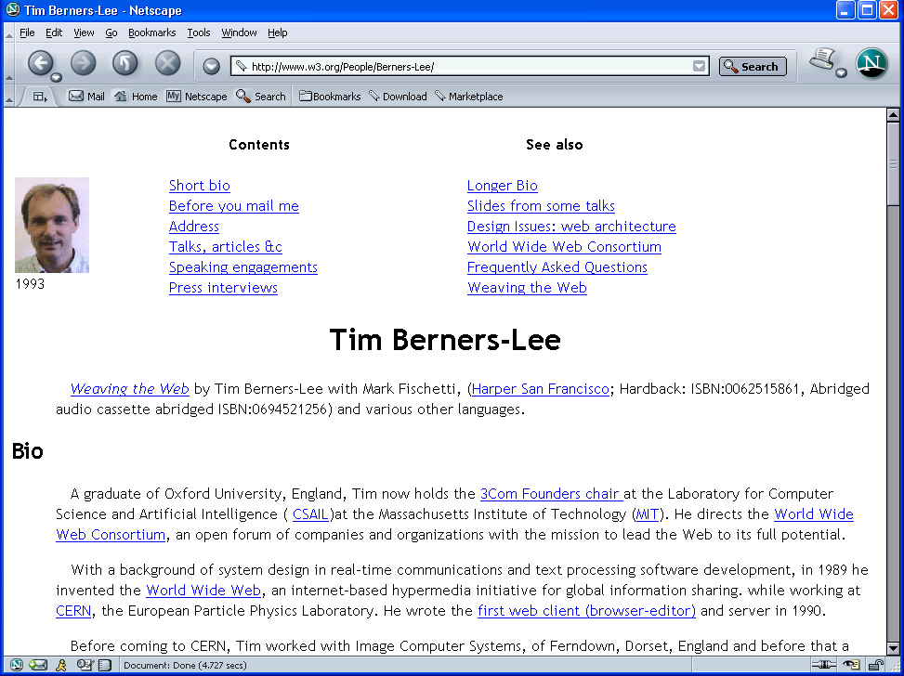
Where we are today: the Syntactic Web
[Hendler & Miller 02]
Spring 2011
Courtesy: Prof Mark Baker (Reading University, UK)
Notes:
14

Slide 15
The Syntactic Web is…
A place where computers do the presentation (easy) and people do the linking and interpreting (hard):
A hypermedia, a digital library:
A library of documents called (web pages) interconnected by a hypermedia of links.
A database, an application platform:
A common portal to applications accessible through web pages, and presenting their results as web pages.
A platform for multimedia:
BBC Radio 4 anywhere in the world!
A naming scheme:
Unique identity for those documents.
Why not get computers to do more of the hard work?
[Goble 03]
Spring 2011
Courtesy: Prof Mark Baker (Reading University, UK)
Notes:
15

Slide 16
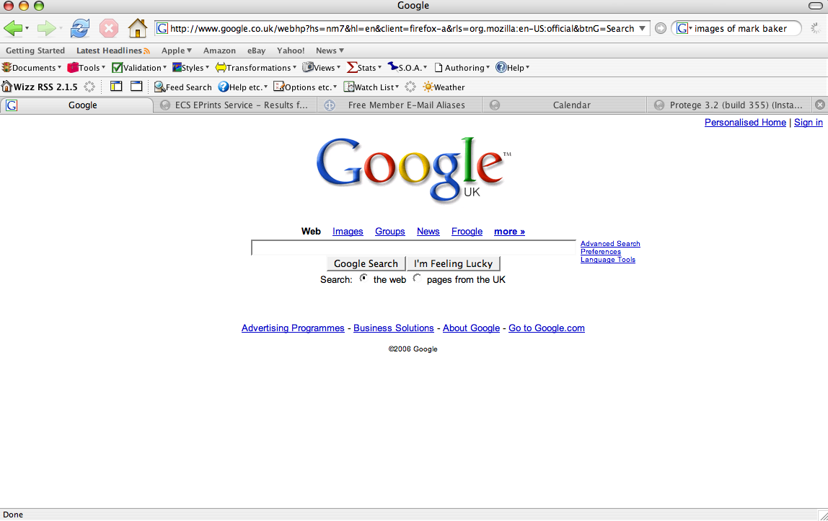
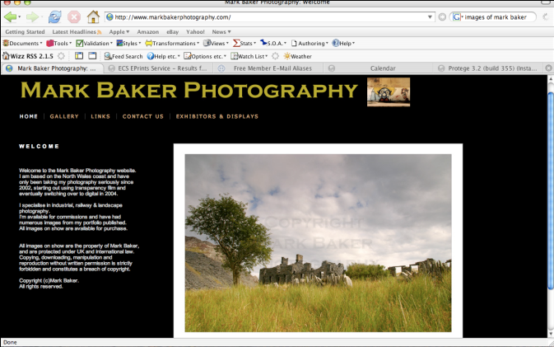
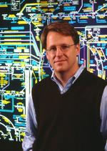
Hard Work using the Syntactic Web…
Find images of Prof Mark Baker (Reading University, UK)
Find images of Ian Foster
Spring 2011
Courtesy: Prof Mark Baker (Reading University, UK)
Notes:
16

Slide 17
Impossible (?) using the Syntactic Web…
Complex queries involving background knowledge:
Find information about “animals that use sonar but are not either bats or dolphins”…
Locating information in data repositories:
Travel enquiries,
Prices of goods and services,
Results of human genome experiments.
Finding and using “Web Services”:
Visualise surface interactions between two proteins.
Delegating complex tasks to web “agents”:
Book me a holiday next weekend somewhere warm, not too far away, and where they speak French or English.
Spring 2011
Courtesy: Prof Mark Baker (Reading University, UK)
Notes:
17

Slide 18
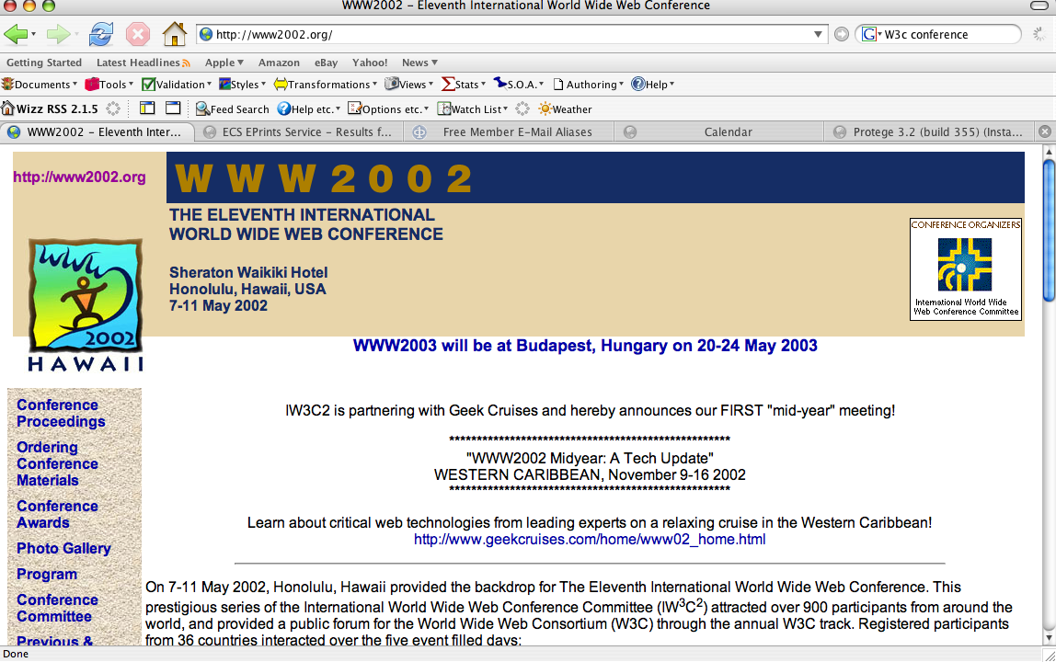
What is the Problem?
Consider a typical web page:
Markup consists of:
Rendering information (e.g., font size and colour),
Hyper-links to related content.
Semantic content is accessible to humans but not (easily) to computers…
Spring 2011
Courtesy: Prof Mark Baker (Reading University, UK)
Notes:
18

Slide 19
What information can we see…
WWW2002
The eleventh international world wide web conference
Sheraton waikiki hotel
Honolulu, hawaii, USA
7-11 may 2002
1 location 5 days learn interact
Registered participants coming from
australia, canada, chile denmark, france, germany, ghana, hong kong, india, ireland, italy, japan, malta, new zealand, the netherlands, norway, singapore, switzerland, the united kingdom, the united states, vietnam, zaire
Register now
On the 7th May Honolulu will provide the backdrop of the eleventh international world wide web conference. This prestigious event …
Speakers confirmed
Tim berners-lee
Tim is the well known inventor of the Web, …
Ian Foster
Ian is the pioneer of the Grid, the next generation internet …
Spring 2011
Courtesy: Prof Mark Baker (Reading University, UK)
Notes:
19

Slide 20
What information can a machine see…




  




…


…

…
Spring 2011
Courtesy: Prof Mark Baker (Reading University, UK)
Notes:
20

Slide 21
Solution: XML markup with “meaningful” tags?
<name>
</name>
<location>
</location>
<date>  </date>
<slogan></slogan>
<participants>
</participants>
<introduction>
…
</introduction>
<speaker></speaker>
<bio></bio>…
Spring 2011
Courtesy: Prof Mark Baker (Reading University, UK)
Notes:
21

Slide 22
Still the Machine only sees…
<>
</>
<>
</>
<>  </>
<></>
<>
</>
<>
…
</>
<></>
<□></□>
<></>
<□></□>
Spring 2011
Courtesy: Prof Mark Baker (Reading University, UK)
Notes:
22

Slide 23
Semantic Web Core concepts
URI = Universal Resource Identifier:
You must name something before you can use it,
URIs should be UNIQUE and STABLE,
But two URIs can identify the same thing.
Rich and Shared Descriptions:
Taxonomies, Thesauri, Ontologies
Common Framework:
Open standards RDF & OWL.
Distributed Nature:
Anywhere on the Web.
Spring 2011
Courtesy: Prof Mark Baker (Reading University, UK)
Notes:
23

Slide 24
Semantic Web Core concepts
RDF = Resource Description Framework:
Vocabularies
Triples: subject, predicate, object,
RDF Model: Nodes and arcs (triples),
RDF serialization: Graph, RDF/XML, N3.
OWL = Web Ontology Language:
Taxonomies: Library catalogues, the animal kingdom,
Thesauruses: WordNet,
RDF Schema (RDFS): A bit like OO modelling (BUT open world, and property centric),
Ontologies: Include all these and more (cardinality, disjoint…).
OWL is the prime semantic web ontology language.
Spring 2011
Courtesy: Prof Mark Baker (Reading University, UK)
Notes:
24
If I have access to a board, I usually give an example:
Basic graph structure:
:ThisTalk :hasAuthor :SteveCayzer :worksAt :HewlettPackard
Now add taxonomy
:ThisTalk :hasSubject :SemWeb :broader :AI
:NeuralNetworks :broader :AI
Now add thesaurus
:SemWeb :hasKeyword :semantic :synonym :meaning
Now add RDFS
:HewlettPackard :class :Company :subClassOf :LegalEntity
:Company :type :Class
:Charity :type :Class
:Charity :subClassOf :LegalEntity
Now add OWL
:Company :disjointWith :Charity
(NB this may not be accurate!)
:Company :hasDirector :Bob
:hasDirector :hasCardinality 1*
(I am finessing how you actually do that in OWL, through some tedious subClassOf Restriction construct which confuses the issue)

Slide 25
Semantic Web Technologies
Trust
Proof
Digital Signature
Rules and logic
Query
Modelling language for data (and metadata)
OWL and RDFS
RDF
XML + Namespaces + xmlschema
Universal (web-based) naming scheme
URI
Spring 2011
Courtesy: Prof Mark Baker (Reading University, UK)
Notes:
25

Slide 26
RDF Example
Media metadata database:
../SemanticWeb.ppt
dc:date
dc:creator
dc:description
Talk on Semantic Web
org:email
2006-11-06
mailto:Courtesy: Prof Mark Baker (Reading University, UK)
Spring 2011
Courtesy: Prof Mark Baker (Reading University, UK)
Notes:
26

Slide 27
RDF Example
Organisation database:
org:Professor
rdf:type
vcard:FN
Prof Mark Baker (Reading University, UK)
org:worksOn
org:email
ex:SemanticWeb
mailto:Courtesy: Prof Mark Baker (Reading University, UK)
Spring 2011
Courtesy: Prof Mark Baker (Reading University, UK)
Notes:
27

Slide 28
RDF Example
Merged database:
/SemanticWeb.ppt
org:Professor
dc:creator
rdf:type
dc:date
dc:description
vcard:FN
Prof Mark Baker (Reading University, UK)
Talk on Semantic Web
org:worksOn
org:email
ex:SemanticWeb
2006-11-06
mailto:Courtesy: Prof Mark Baker (Reading University, UK)
Spring 2011
Courtesy: Prof Mark Baker (Reading University, UK)
Notes:
28

Slide 29
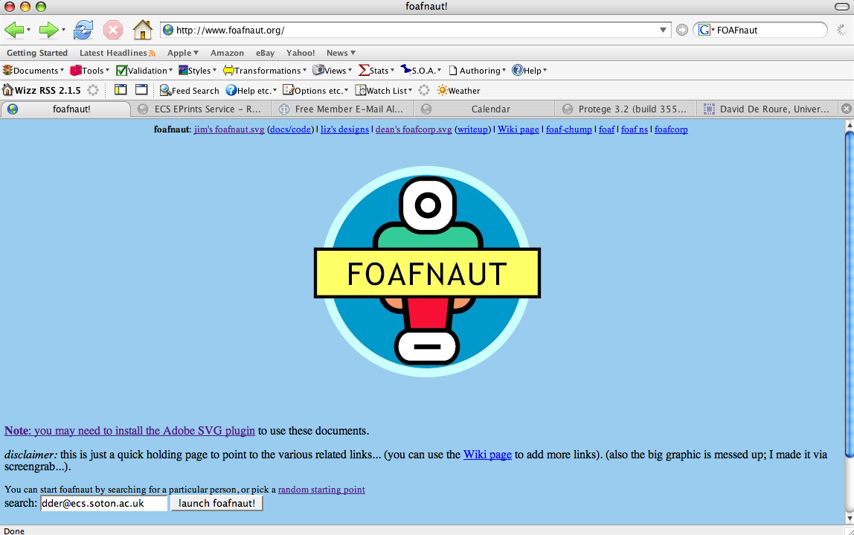
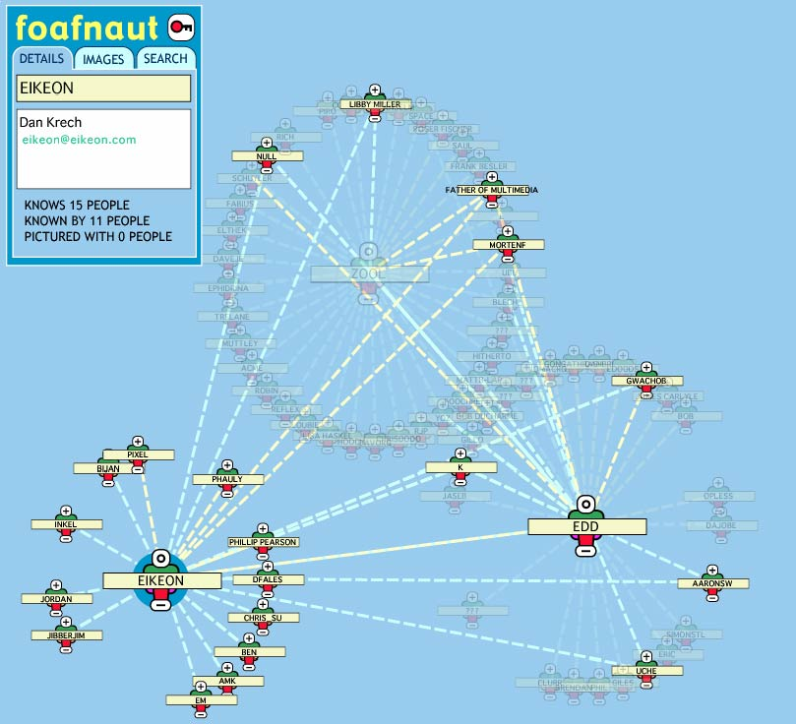
FOAF:Semantic Web case study
The Friend of a Friend (FOAF) project is about creating a Web of machine-readable homepages describing people, the links between them and the things they create and do.
Distributed RDF/XML records describing people, who they know, projects they work on…
Spring 2011
Courtesy: Prof Mark Baker (Reading University, UK)
Notes:
29
FOAF is a nice example of a real semantic web application.
The idea to is encode your details (name, email, homepage…) in RDF but ALSO to record links to people you ‘know’.
Thus we can encode both useful details (think of Vcards) but also communities (so, I am more likely to trust someone I don’t know who’s a friend of my friend). Note though, that ‘knows’ does not necessarily imply ‘friend’. Also, that the transitive nature of friendship, or trust, is not guaranteed. As in the misconception “My enemy’s enemy is my friend”.
Certain commercial social networking outfits (eg MovableType blogs, ecademy) use Foaf to add value to their offerings
The picture is from Jim Ley’s FOAFnaut, a way of visualising FOAF communities.
Note that FOAF is used to encode LiveJournal user profiles

Slide 30
A simple FOAF model
foaf:Person
rdf:type
foaf:name
Prof Mark Baker (Reading University, UK)
foaf:mbox
mailto:mm@example.com
Spring 2011
Courtesy: Prof Mark Baker (Reading University, UK)
Notes:
30
The idea here is partly to encourage thought and interaction, but also to show how quickly a graph gets messy and hard to understand.
Foaf profiles are a nice way to introduce the RDF model.
Here’s a simple example consisting of 3 triples (node-arc-node, or subject-predicate-object) (all with the same subject).
Note the anonymous node! The person (Prof Mark Baker (Reading University, UK)) does not have a URI!
So how come the subject doesn’t need a URI? A subtle point, and it’s because Michael can be identified unambiguously by his email address (we assume that 2 different individuals don’t ever share the same email address, a potentially erroneous assumption of course but logically sound). The mbox property (in OWL jargon) is called an inverse functional property.
The point has practical implications. If Mark needs a URI (something arbitrary like urn:168892390a), then people wanting to say ‘I know Mark’ need to know it (or find it out). Much easier to say (“I know the person whose email address is…”) because we will typically know that.

Slide 31
.. which can be serialized in XML
<rdf:RDF
xmlns:rdf="http://www.w3.org/1999/02/22-rdf-syntax-ns#"
xmlns:foaf="http://xmlns.com/foaf/0.1/">
<foaf:Person>
<foaf:name>Prof Mark Baker (Reading University, UK)</foaf:name>
<foaf:mbox rdf:resource="mailto:mm@example.com" />
</foaf:Person>
</rdf:RDF>
Spring 2011
Courtesy: Prof Mark Baker (Reading University, UK)
Notes:
31
Just to show an example, the model just described can be serialized in XML.
For more details on this, see the RDF primer
http://www.w3.org/TR/2004/REC-rdf-primer-20040210/
The idea here is not to give a tutorial on RDF/XML syntax but just to give a taster of what it looks like.

Slide 32
.. and N3
@prefix rdf <http://www.w3.org/1999/02/22-rdf-syntax-ns#>
@prefix foaf <http://xmlns.com/foaf/0.1/>
[] a foaf:Person;
foaf:name “Prof Mark Baker (Reading University, UK)”;
foaf:mbox <mailto:mm@example.com> .
Spring 2011
Courtesy: Prof Mark Baker (Reading University, UK)
Notes:
32
The N3 syntax is (for some) more intuitive than XML, though there are fewer parsers around.
The point of this slide is neither to provide an introduction to N3, for which see the primer
http://www.w3.org/2000/10/swap/Primer
Nor even really to show you what it looks like (though that’s a subsidiary goal).
The aim here is to reinforce the point that there’s more than one way to serialize RDF
- or to put it another way, it’s about the model not the syntax.

Slide 33
A more complex foaf model
foaf:Person
foaf:Person
rdf:type
rdf:type
foaf:name
foaf:name
foaf:knows
Prof Mark Baker (Reading University, UK)
Rich Boakes
foaf:mbox
foaf:mbox
mailto:mm@example.com
mailto:rb@example.com
Spring 2011
Courtesy: Prof Mark Baker (Reading University, UK)
Notes:
33
Here’s a more complex FOAF example. Here Mark‘s profile remains unchanged except that he is linked to another similar foaf profile, Rich.
Note that the usual link in FOAF is ‘knows’ (which could be ‘likes’, ‘is married to’, ‘has had a conversation with’, ‘is aware of’ or even ‘is arch enemy of’!) This semantic vagueness is deliberate, but whether this design decision turns out to be correct, time will tell.

Slide 34
A more complex FOAF example
<foaf:Person>
<foaf:name>Prof Mark Baker (Reading University, UK)</foaf:name>
<foaf:mbox rdf:resource="mailto:mm@example.com"/>
<foaf:knows>
<foaf:Person>
<foaf:mbox rdf:resource="mailto:rb@example.com" />
<foaf:name>Rich Boakes</foaf:name>
</foaf:Person>
</foaf:knows>
</foaf:Person>
Spring 2011
Courtesy: Prof Mark Baker (Reading University, UK)
Notes:
34

Slide 35
A more complex FOAF example
[] a foaf:Person;
foaf:name “Prof Mark Baker (Reading University, UK)”;
foaf:mbox <mailto:mm@example.com>;
foaf:knows [
a foaf:Person;
foaf:mbox <mailto:rb@example.com>;
foaf:name “Rich Boakes”
].

Slide 36
In what follows…
We will use a simplistic example to introduce the main Semantic Web concepts

Slide 37
The rough structure of data integration
Map the various data onto an abstract data representation
make the data independent of its internal representation…
Merge the resulting representations
Start making queries on the whole!
queries not possible on the individual data sets

Slide 38
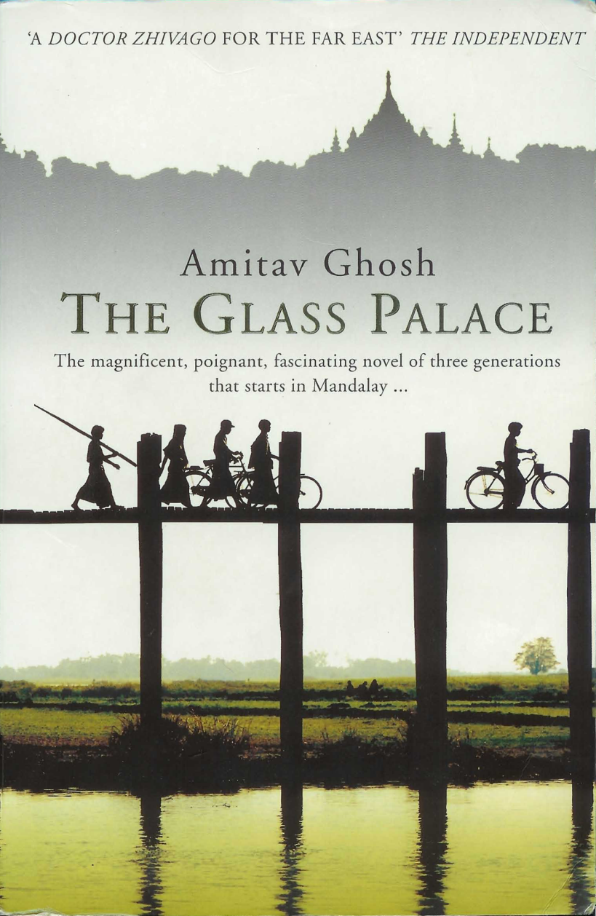
We start with a book...

Slide 39
A simplified bookstore data (dataset “A”)
ID | Author | Title | Publisher | Year
ISBN 0-00-6511409-X | id_xyz | The Glass Palace | id_qpr | 2000
ID | Name | Homepage
id_xyz | Ghosh, Amitav | http://www.amitavghosh.com
ID | Publisher’s name | City
id_qpr | Harper Collins | London

Slide 40
1st: export your data as a set of relations
a:title
The Glass Palace
http://…isbn/000651409X
2000
a:year
a:publisher
London
a:city
a:author
Harper Collins
a:p_name
a:name
a:homepage
Ghosh, Amitav
http://www.amitavghosh.com

Slide 41
Some notes on the exporting the data
Relations form a graph
the nodes refer to the “real” data or contain some literal
how the graph is represented in machine is immaterial for now

Slide 42
Some notes on the exporting the data
Data export does not necessarily mean physical conversion of the data
relations can be generated on-the-fly at query time
via SQL “bridges”
scraping HTML pages
extracting data from Excel sheets
etc.
One can export part of the data

Slide 43

Same book in French…

Slide 44
Another bookstore data (dataset “F”)
 | A | B | C | D
1 | ID | Titre | Traducteur | Original
2 | ISBN 2020286682 | Le Palais des Miroirs | $A12$ | ISBN 0-00-6511409-X
3
4
5
6 | ID | Auteur
7 | ISBN 0-00-6511409-X | $A11$
8
9
10 | Nom
11 | Ghosh, Amitav
12 | Besse, Christianne

Slide 45
2nd: export your second set of data
http://…isbn/000651409X
Le palais des miroirs
f:original
f:titre
f:auteur
http://…isbn/2020386682
f:traducteur
f:nom
f:nom
Ghosh, Amitav
Besse, Christianne

Slide 46
3rd: start merging your data
The Glass Palace
a:title
http://…isbn/000651409X
2000
a:year
a:city
a:publisher
London
Harper Collins
a:p_name
a:author
a:name
http://…isbn/000651409X
a:homepage
f:original
Le palais des miroirs
Ghosh, Amitav
http://www.amitavghosh.com
f:titre
f:auteur
http://…isbn/2020386682
f:traducteur
f:nom
Ghosh, Amitav
f:nom
Besse, Christianne

Slide 47
3rd: start merging your data (cont)
The Glass Palace
a:title
http://…isbn/000651409X
2000
a:year
a:publisher
Same URI!
London
a:city
Harper Collins
a:p_name
a:author
a:name
http://…isbn/000651409X
a:homepage
f:original
Le palais des miroirs
Ghosh, Amitav
http://www.amitavghosh.com
f:titre
f:auteur
http://…isbn/2020386682
f:traducteur
f:nom
Ghosh, Amitav
f:nom
Besse, Christianne

Slide 48
3rd: start merging your data
The Glass Palace
a:title
http://…isbn/000651409X
2000
a:year
a:city
a:publisher
London
Harper Collins
a:p_name
a:author
f:original
a:name
f:auteur
a:homepage
Le palais des miroirs
Ghosh, Amitav
http://www.amitavghosh.com
f:titre
http://…isbn/2020386682
f:traducteur
f:nom
Ghosh, Amitav
f:nom
Besse, Christianne

Slide 49
Start making queries…
User of data “F” can now ask queries like:
“give me the title of the original”
well, … « donnes-moi le titre de l’original »
This information is not in the dataset “F”…
…but can be retrieved by merging with dataset “A”!

Slide 50
However, more can be achieved…
We “feel” that a:author and f:auteur should be the same
But an automatic merge doest not know that!
Let us add some extra information to the merged data:
a:author same as f:auteur
both identify a “Person”
a term that a community may have already defined:
a “Person” is uniquely identified by his/her name and, say, homepage
it can be used as a “category” for certain type of resources

Slide 51
3rd revisited: use the extra knowledge
The Glass Palace
a:title
http://…isbn/000651409X
2000
a:year
f:original
Le palais des miroirs
a:publisher
f:titre
London
a:city
Harper Collins
a:p_name
a:author
f:auteur
http://…isbn/2020386682
r:type
f:traducteur
a:name
http://…foaf/Person
r:type
f:nom
a:homepage
f:nom
Besse, Christianne
Ghosh, Amitav
http://www.amitavghosh.com

Slide 52
Start making richer queries!
User of dataset “F” can now query:
“donnes-moi la page d’accueil de l’auteur de l’original”
well… “give me the home page of the original’s ‘auteur’”
The information is not in datasets “F” or “A”…
…but was made available by:
merging datasets “A” and datasets “F”
adding three simple extra statements as an extra “glue”

Slide 53
Combine with different datasets
Using, e.g., the “Person”, the dataset can be combined with other sources
For example, data in Wikipedia can be extracted using dedicated tools
e.g., the “dbpedia” project can extract the “infobox” information from Wikipedia already…

Slide 54
Merge with Wikipedia data
The Glass Palace
a:title
http://…isbn/000651409X
2000
a:year
f:original
Le palais des miroirs
a:publisher
f:titre
London
a:city
Harper Collins
a:p_name
a:author
f:auteur
http://…isbn/2020386682
r:type
f:traducteur
a:name
http://…foaf/Person
r:type
f:nom
a:homepage
r:type
f:nom
Besse, Christianne
Ghosh, Amitav
http://www.amitavghosh.com
foaf:name
w:reference
http://dbpedia.org/../Amitav_Ghosh

Slide 55
Merge with Wikipedia data
The Glass Palace
a:title
http://…isbn/000651409X
2000
a:year
f:original
Le palais des miroirs
a:publisher
f:titre
London
a:city
Harper Collins
a:p_name
a:author
f:auteur
http://…isbn/2020386682
r:type
f:traducteur
a:name
http://…foaf/Person
r:type
f:nom
a:homepage
r:type
f:nom
w:isbn
Besse, Christianne
Ghosh, Amitav
http://www.amitavghosh.com
foaf:name
w:reference
http://dbpedia.org/../The_Glass_Palace
w:author_of
http://dbpedia.org/../Amitav_Ghosh
w:author_of
http://dbpedia.org/../The_Hungry_Tide
w:author_of
http://dbpedia.org/../The_Calcutta_Chromosome

Slide 56
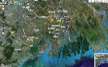
Merge with Wikipedia data
The Glass Palace
a:title
http://…isbn/000651409X
2000
a:year
f:original
Le palais des miroirs
a:publisher
f:titre
London
a:city
Harper Collins
a:p_name
a:author
f:auteur
http://…isbn/2020386682
r:type
f:traducteur
a:name
http://…foaf/Person
r:type
f:nom
a:homepage
r:type
f:nom
w:isbn
Besse, Christianne
Ghosh, Amitav
http://www.amitavghosh.com
foaf:name
w:reference
http://dbpedia.org/../The_Glass_Palace
w:author_of
http://dbpedia.org/../Amitav_Ghosh
w:born_in
w:author_of
http://dbpedia.org/../Kolkata
http://dbpedia.org/../The_Hungry_Tide
w:long
w:lat
w:author_of
http://dbpedia.org/../The_Calcutta_Chromosome

Slide 57
Additional Material

Slide 58
Semantic Web Technologies
Trust
Ontology languages for representing the semantics of data
Proof
Digital Signature
Rules and logic
Query
Modelling language for data (and metadata)
OWL and RDFS
RDF
XML + Namespaces + xmlschema
RDF, RDFS, OWL standardised February 2004
Universal (web-based) naming scheme
URI
Spring 2011
Courtesy: Prof Mark Baker (Reading University, UK)
Notes:
58

Slide 59
Semantic Web Ontology Languages
RDFS
Student is a sub-class of Person
Friend is a sub-property of Knows
OWL
Lions only eat meat
The ‘ancestor’ relationship is transitive
People have exactly one shoe size
An email address unambiguously identifies one person
All things with a “Married” property are of class Person
Spring 2011
Courtesy: Prof Mark Baker (Reading University, UK)
Notes:
59
Here’s some simple examples, with the syntax ignored.
There are some subtleties (do lions eat anything at all?) and some necessary simplifications (people sharing email addresses)
RDFS and OWL give you the vocabulary to describe your own data model.
How complex or realistic the model is, is up to you (hint: it will never be totally accurate. All models are wrong, but some are useful. As simple as possible, as complex as necessary is a good maxim).
As a historical aside, OWL grew out of 2 precursor projects
DAML (DARPA agent markup language) http://www.daml.org/
And
OIL(Ontology Inference Layer ) http://www.ontoknowledge.org/oil/
Which were combined as DAML+OIL
http://www.daml.org/2001/03/daml+oil-index.html
This formed the starting point for OWL.

Slide 60
Semantic Web Technologies
Ways of transforming data between ontologies
Current research areas
Query and data access protocol
Trust
Ontology languages for representing the semantics of data
Proof
Digital Signature
Rules and logic
Query
Modelling language for data (and metadata)
OWL and RDFS
RDF
RDF, RDFS, OWL standardised Feb 2004
SPARQL query language: W3C Candidate Rec April 2006
XML + Namespaces + xmlschema
Universal (web-based) naming scheme
URI
Spring 2011
Courtesy: Prof Mark Baker (Reading University, UK)
Notes:
60
Rules: ‘you say tomayto, I say tomato’ – but we mean the same thing. Less flippantly, is ‘UK’ the same thing as ‘Great Britain’? Not quite, but can we encode the translation in a rule? (If UK AND not N. Ireland THEN GB). Rules Interchange Format (RIF) being discussed at W3C, may become a standard in next 2-3 years.
Proof: If I take something back to a shop, they’ll want to know I bought it there. How do I prove it? A receipt – ie a piece of metadata attached to the transaction. On the web, we’ll want added assurance that this metadata is not ‘faked’ – that it really did come from the shop. This is called provenance and will probably be implemented using digital signatures.
Trust: Who should I listen to? My friends? My family? An acknowledged world expert? What about my friends’ recommendations? Friends of friends? Is trust transitive?

Slide 61
Need to add “Semantics”
External agreement on meaning of annotations:
e.g., Dublin Core for annotation of library/bibliographic information:
Agree on the meaning of a set of annotation tags.
Problems with this approach:
Inflexible,
Limited number of things can be expressed.
Use Ontologies to specify meaning of annotations:
Ontologies provide a vocabulary of terms,
New terms can be formed by combining existing ones
“Conceptual Lego”,
Meaning (semantics) of such terms is formally specified,
Can also specify relationships between terms in multiple ontologies.
Spring 2011
Courtesy: Prof Mark Baker (Reading University, UK)
Notes:
61

Slide 62
Ontology: Origins and History
Ontology in Philosophy:
“a philosophical discipline — a branch of philosophy that
deals with the nature and the organisation of reality“
Science of Being (Aristotle, Metaphysics, IV, 1)
Tries to answer the questions:
What characterises being?
Eventually, what is being?
How should things be classified?
Spring 2011
Courtesy: Prof Mark Baker (Reading University, UK)
Notes:
62

Slide 63
Ontology in Linguistics
Concept
Relates to
activates
Form
Referent
Stands for
“Tank“
?
[Ogden, Richards, 1923]
Spring 2011
Courtesy: Prof Mark Baker (Reading University, UK)
Notes:
63
May introduce here simple ontologies

Slide 64
Ontology in Computer Science
An ontology is an engineering artifact:
It is constituted by a specific vocabulary used to describe a certain reality, plus,
a set of explicit assumptions regarding the intended meaning of the vocabulary:
Almost always including how concepts should be classified.
Thus, an ontology describes a formal specification of a certain domain:
Shared understanding of a domain of interest,
Formal and machine manipulable model of a domain of interest.
“An explicit specification of a conceptualisation” [Gruber93]
Spring 2011
Courtesy: Prof Mark Baker (Reading University, UK)
Notes:
64

Slide 65
Where else are ontologies used?
Bioinformatics:
The Gene Ontology,
The Protein Ontology (MGED).
Medicine:
“The terminology wars”.
Linguistics.
Database integration.
User interface design.
Fractal Indexing.
Spring 2011
Courtesy: Prof Mark Baker (Reading University, UK)
Notes:
65

Slide 66
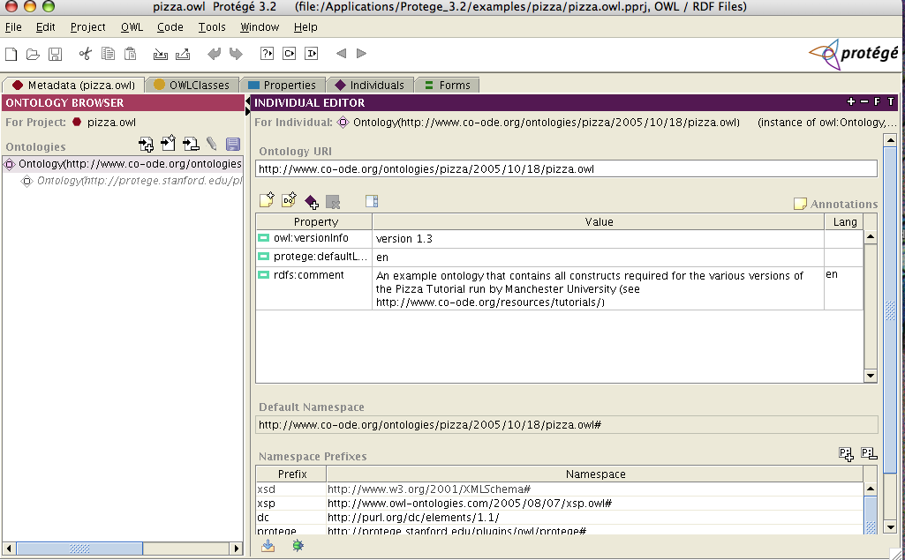
Ontology Editor - Protege
Spring 2011
Courtesy: Prof Mark Baker (Reading University, UK)
Notes:
66

Slide 67
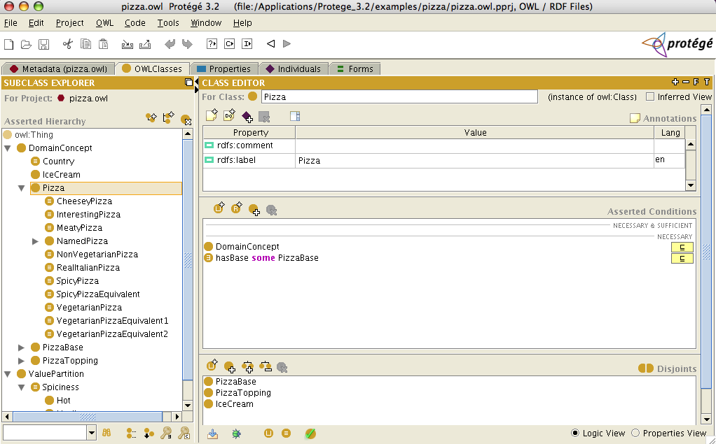
Ontology Editor - Protege
Spring 2011
Courtesy: Prof Mark Baker (Reading University, UK)
Notes:
67

Slide 68
Ontologies and data sources
Index of different ontologies
http://swoogle.umbc.edu/
Joined-up data
http://linkeddata.org/
http://data.gov.uk/
http://dbpedia.org/

Slide 69
RDF is not XML!
The Semantic Web is about data modelling.
RDF describes this model.
The model can be expressed in XML (or N3, or drawn as a graph…).
XML Schema is all about syntax and so has limited use for RDF.
RDF Schema is all about the model.
Spring 2011
Courtesy: Prof Mark Baker (Reading University, UK)
Notes:
69

Slide 70
Summary
The semantic web is about globally sharing, processing and integrating information.
RDF is a model.
RDF is not XML, though it may be serialized in XML.
Semantic Web technologies range from production ready (the lower layers) to active research areas (the upper layers).
Available across the Web now… see http://www.rkbexplorer.com/
Spring 2011
Courtesy: Prof Mark Baker (Reading University, UK)
Notes:
70
The semantic web is still controversial, though more and more people are starting to believe that at least some parts of it (the description bit) will be useful. Some scathing attacks on the higher levels, especially logic and trust.
See the entertaining rant from Clay Shirky
http://www.shirky.com/writings/semantic_syllogism.html
But be sure to read the balanced summary of the ensuing discussion from Peter van Dijk
http://www.poorbuthappy.com/ease/semantic/

Slide 71
The Semantic Web today
A set of open standards that include:
A simple, flexible, composable data model,
A way of describing the semantics of the data.
A collection of technologies which support these standards.
A quick way of integrating data – both structured and semi-structured – from a number of disparate data sources.
A web-style approach: data can be owned and managed locally; data models can evolve as new data emerges.
Spring 2011
Courtesy: Prof Mark Baker (Reading University, UK)
Notes:
71

Slide 72
A different way of working…
Research Focused:
Predicting (or inventing) the future.
Web scale:
Collecting, querying, integrating huge piles of data
Decentralised, lack of control.
Open standards:
No royalties to collect!
Open source:
We give our code away (and even support it)
Open world:
Anybody can say anything about anything (at any time).
Spring 2011
Courtesy: Prof Mark Baker (Reading University, UK)
Notes:
72

